Slide 1
GOBEL
Measuring What Matters:
Turning KPIs into Strategic Drivers of Philanthropy
Council for Advancement and Support of Education © 2026

Slide 2
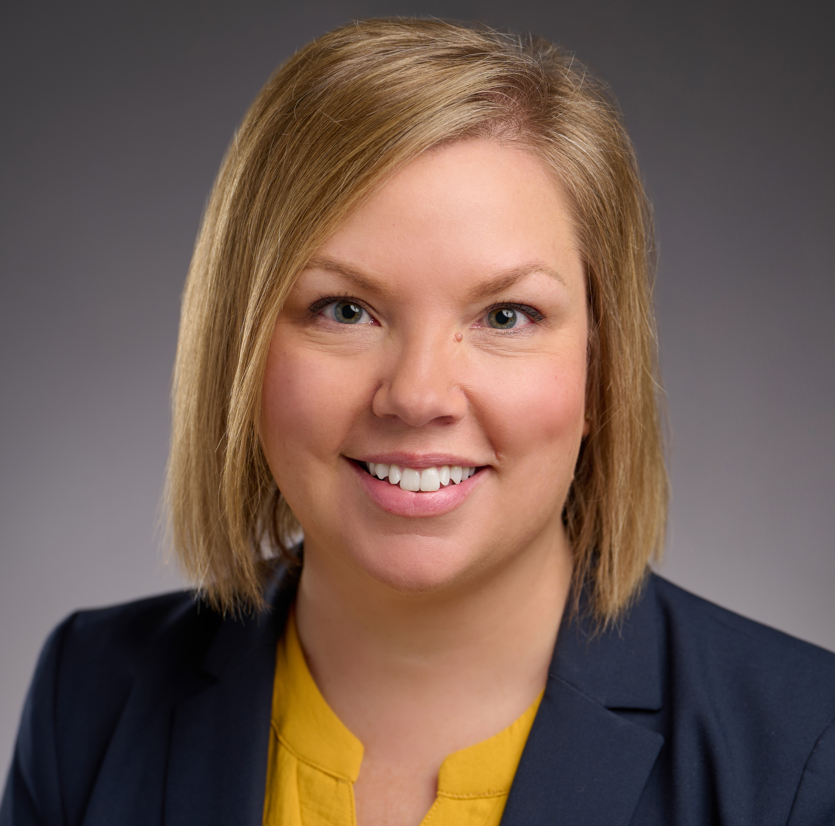
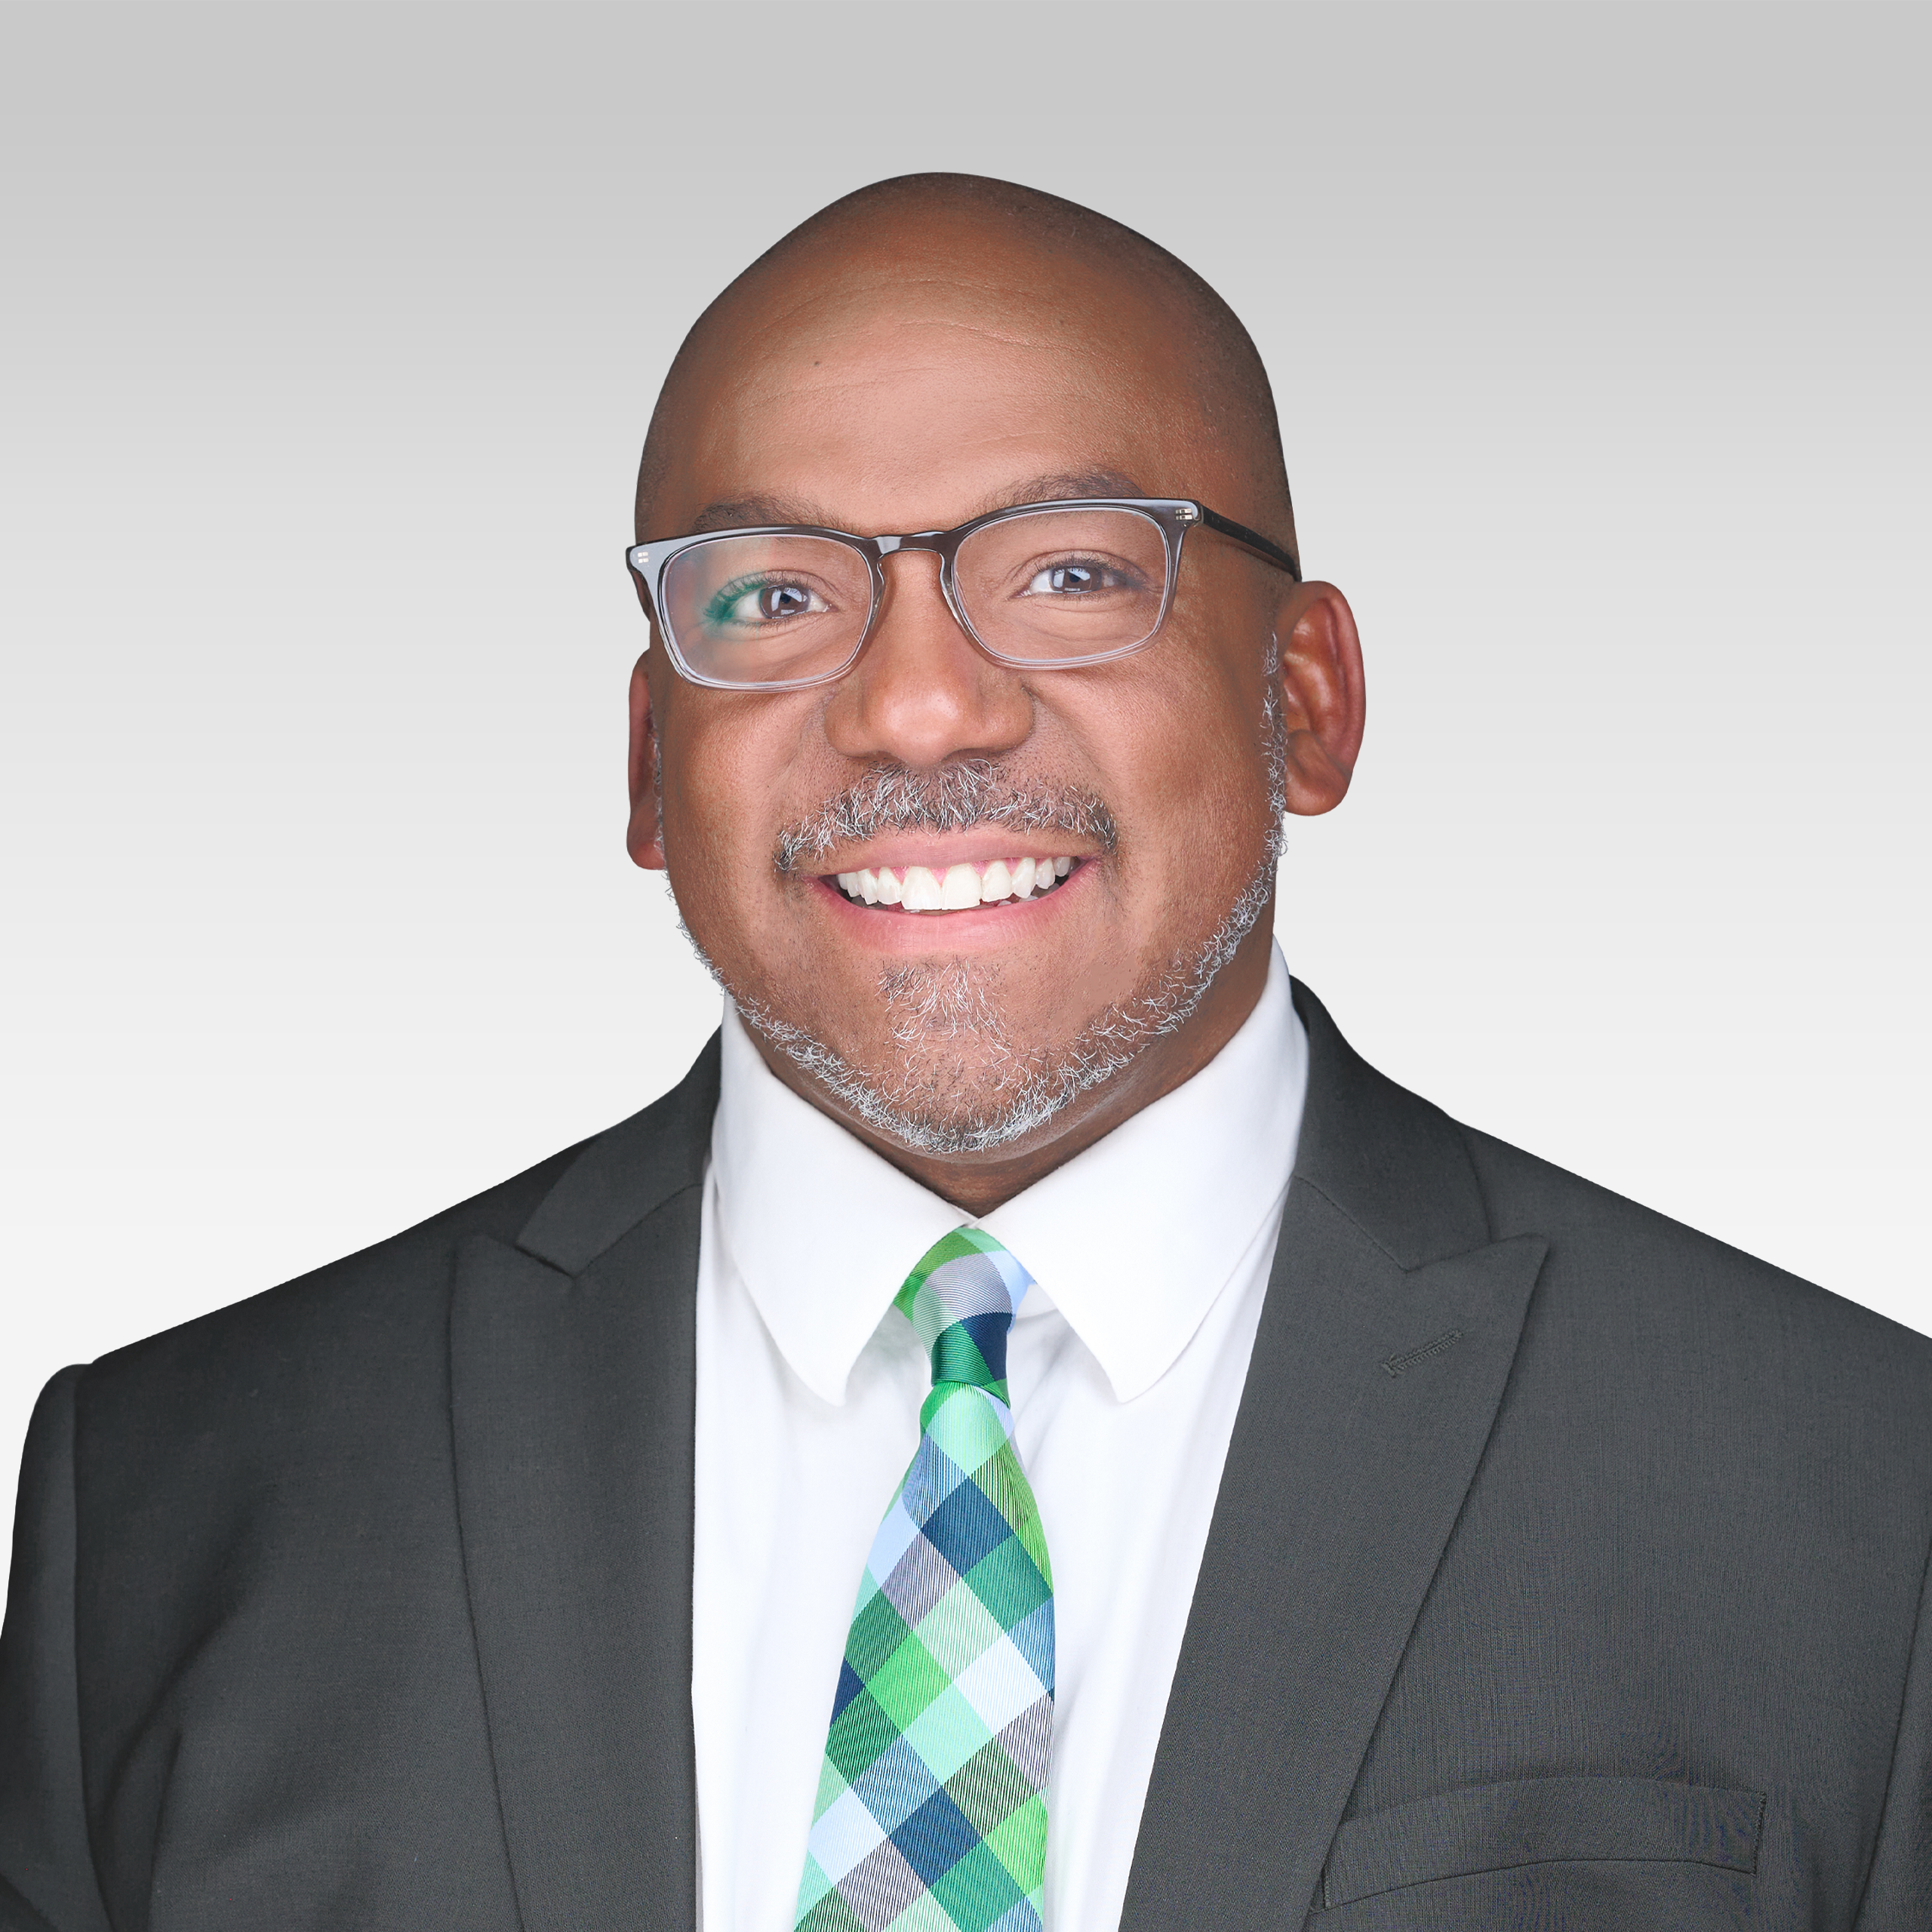
Introductions
GOBEL
ET
AS
Erin Thompson
Adrian Stover
Director of Foundation and
Healthcare Philanthropy
Froedtert & Medical College of Wisconsin
Associate Vice President,
Philanthropy Services
GOBEL
2

Slide 3
GOBEL
What is Grateful Patient
Philanthropy?
3

Slide 4
Philanthropy in Patient Experience
GOBEL
Philanthropy is ultimately not about money. It is about allowing grateful patients to express their gratitude.
It is an integral part of the patient's clinical experience.
Not a financial transaction but an important component in a patient and family healing journey.
Philanthropy is a natural extension and continuation of the clinician experience.
4

Slide 5
GOBEL
The Power of Gratitude
5

Slide 6
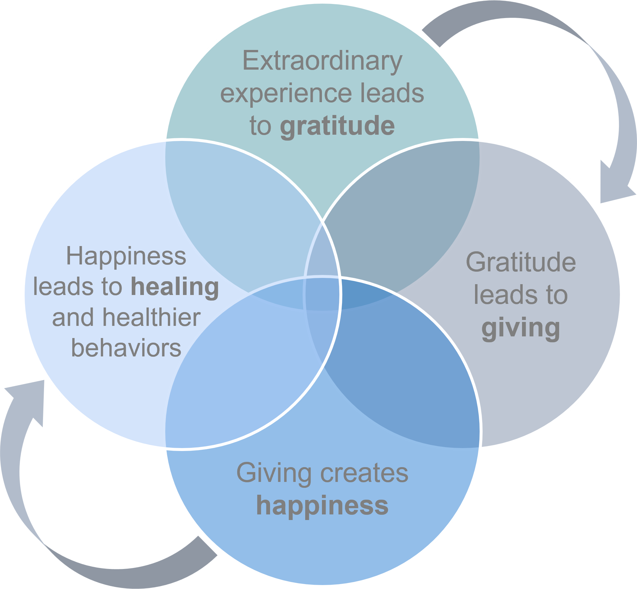
The Power of Gratitude

Slide 7
Grateful Patient Outcomes
GOBEL
Scientific and medical research has demonstrated that grateful people are healthier people.
In addition to proven health benefits of gratitude, the grateful individual or family is moved by the wish to return the good they have received.
Expressions of gratitude may be as simple as writing a thank you note or making a donation.
Even when a clinician unintentionally rejects gratitude, the patient attempting to express appreciation feels dismissed or disrespected.
Clinicians who better understand why patients need to express gratitude are more likely to receive it properly.
6

Slide 8
Make the Case for the Importance of Philanthropy
GOBEL
CEO Engagement
Make Your Case
Nationally, CEOs are spending more time on philanthropy than ever before — that's good news.
Identify your baseline of philanthropy. Identify your opportunity for growth. Show the trajectory of growth. Identify the cost and ROI, but focus on net return.
Culture of Philanthropy
Leadership Engagement
Today's successful environments require a culture of philanthropy throughout the entire organization.
Leadership engagement in the donor cultivation cycle is essential.
7

Slide 9
GOBEL
Froedtert & The Medical
College of Wisconsin
+ GOBEL
8

Slide 10
Froedtert & The Medical College of Wisconsin
GOBEL
Academic medical center based in Milwaukee, WI
Two previous grateful patient fundraising program attempts
Desire to implement a sustainable program
9

Slide 11
About GOBEL
GOBEL
#1 Firm
$4B+
40+
with dual expertise in consulting & technology for healthcare philanthropy
in philanthropic revenue generated by GOBEL clients annually
professionals with 750+ years of collective experience from top medical centers
300
20+
Patented
hospitals as active clients. 1,000 prior engagements including 400 campaigns
campaigns supported with $4B in goals under management
data analytics leader with patented gratitude scoring and data solutions
10

Slide 12
GOBEL
Key Performance
Indicators Setup
11

Slide 13
F&MCW KPI Goals
GOBEL
Build a best-in-class and scalable Grateful Patient and Family Philanthropy Program
Enhance and expand the current culture of philanthropy with external and internal stakeholders of F&MCW
Increase direct and screened referrals and track engagement
Expand data operations resources to develop and build key performance indicators dashboard to track fundraising activity
Launch KPIs dashboard to assist with driving strategic decision making
12

Slide 14
Key Performance Indicators
GOBEL
# Champions
# Champions
Engaged
# Referrals
# Qualification
Visits
# Prospects
Qualified
# Solicitations
Value of
Solicitations
# Gifts
Closed
Value of
Gifts
Additional Gifts
13

Slide 15
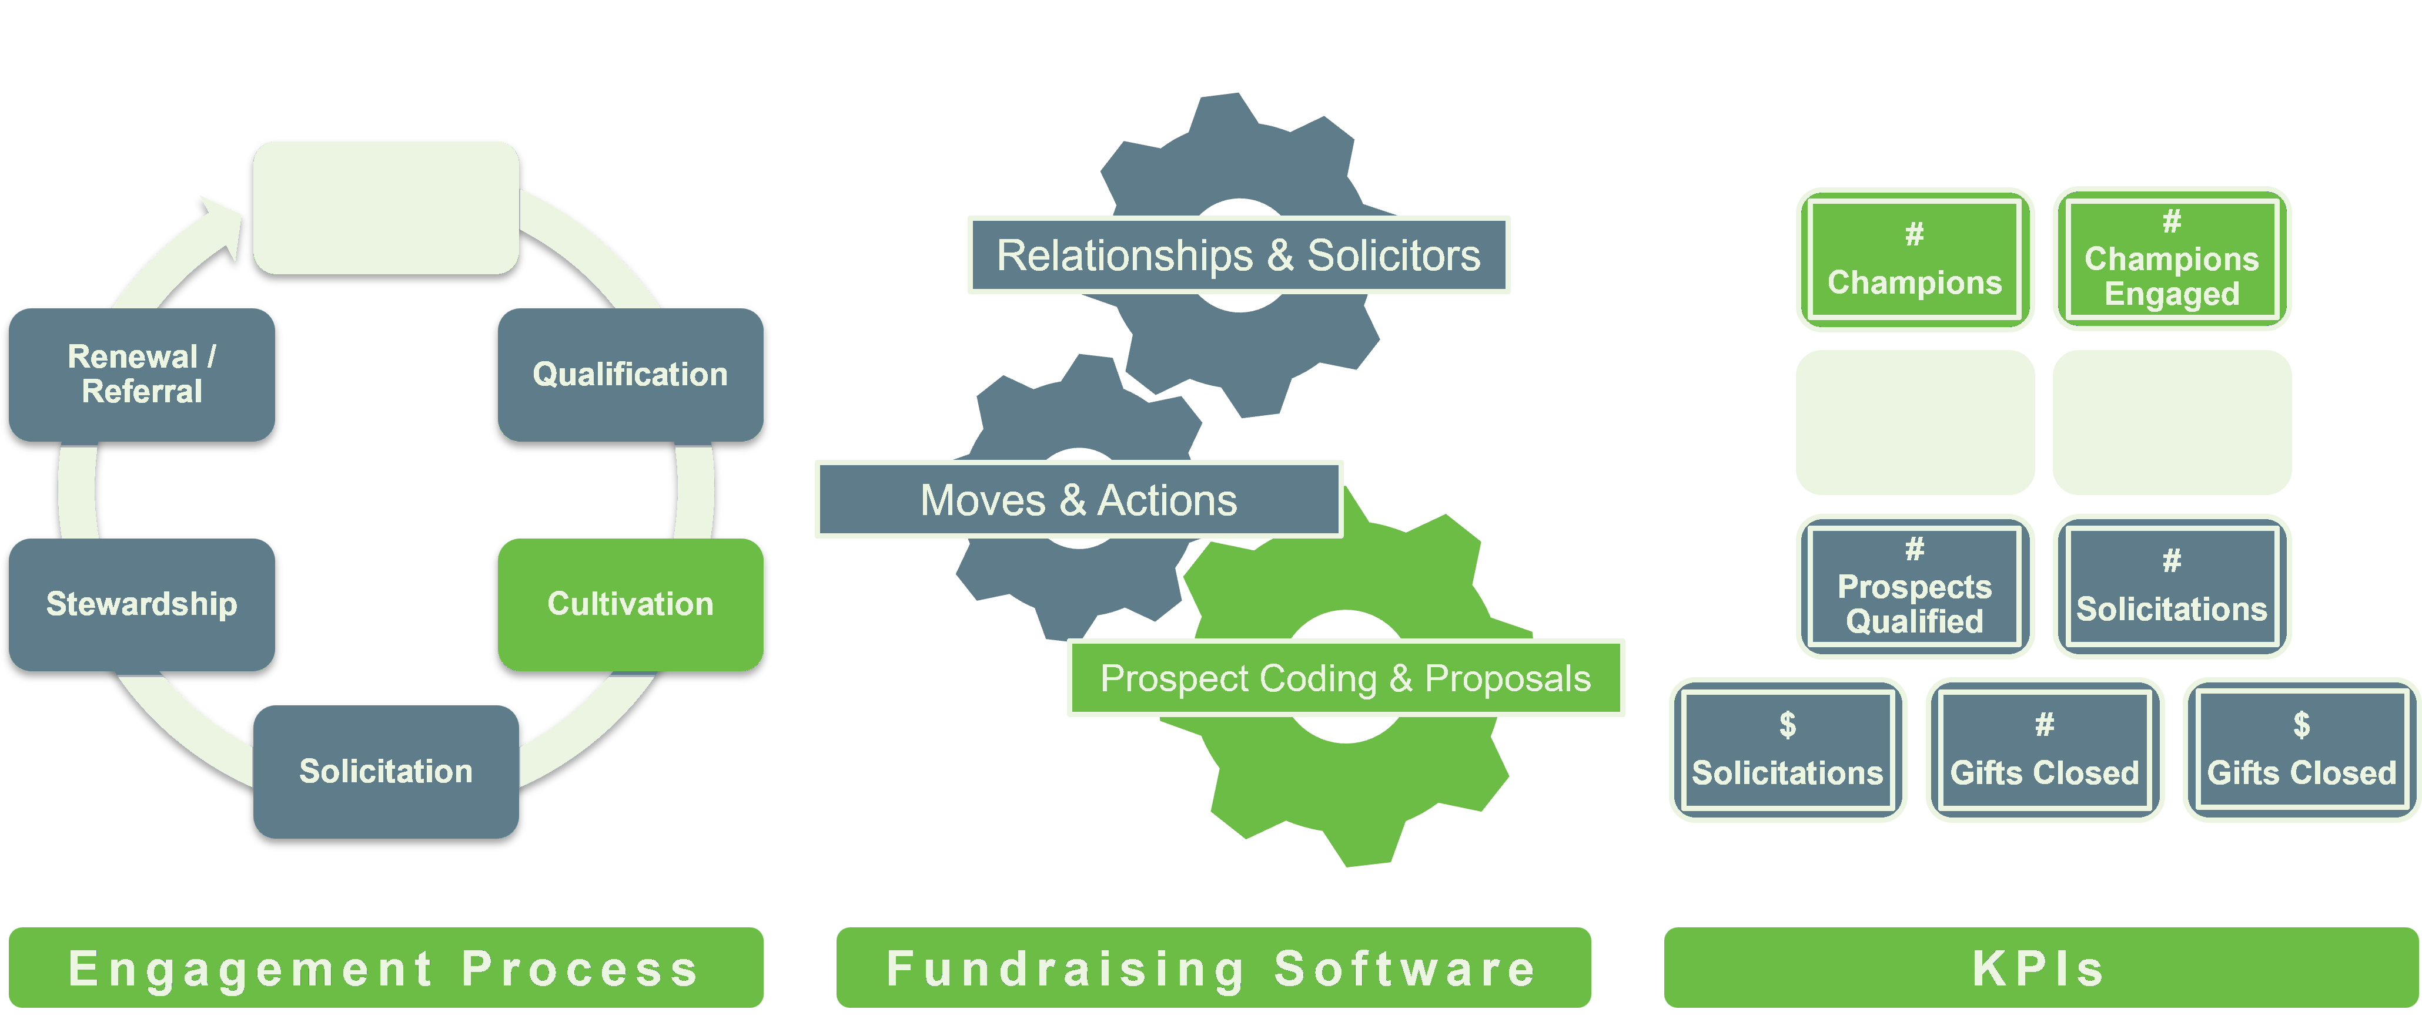
Tracking Your Success
GOBEL
Identification
# Referrals
#
Qual. Visits
14

Slide 16
Key Drivers
GOBEL
Clinician Engagement
Frontline Fundraisers
# of Champions Identified
# of Prospects Identified
# of Prospects Qualified
# of Prospects Cleared
# of Meaningful Interactions
# of Meaningful Interactions
Time Spent in Stage
# and $ of Asks
# and $ of Gifts Closed
15

Slide 17
KPI Exercise
GOBEL
📋 REFLECTION QUESTIONS
📅 MONTHLY TARGETS
1. What is your goal for dollars raised?
🚶 Visits
_______________
2. What is your average gift?
💬 Asks
3. How many gifts do you need to close to reach your goal?
_______________
4. How many asks do you need to make to reach your goal?
🎁 Gifts Closed
5. How many visits do you need to make to close a gift?
_______________
💡 What are your monthly targets for visits, asks, and gifts closed?
16

Slide 18
Prospect Management Best Practices
GOBEL
Define who is responsible for tracking measurements and how.
Measure what you value, and value what you measure.
Will this be in the database? If so, where?
What metrics evaluate the prospect development team?
Will this be in a separate spreadsheet? If so, where will the data come from?
What metrics evaluate development officers?
How will you extract the data in a usable format?
What are best practices of peer fundraising offices?
Determine how often data will be extracted and analyzed.
Determine how to track items to benchmark against other organizations.
Develop processes to accurately track data across the team.
Integrate key metrics with dashboards for senior leadership.
17

Slide 19
Challenges
GOBEL
Clinician Availability
Qualification
Turnover
Coordinating schedules with busy clinicians requires flexible approaches and persistent follow-through.
Accurately identifying and qualifying grateful patient prospects demands both data and strong intuition.
Staff and clinician turnover impacts relationship continuity and requires robust onboarding processes.
Top barrier
to program growth
Requires data
+ relationship insight
Continuity risk
across all roles
18

Slide 20
Program Impact
GOBEL
$12,500,000+
$246,716
raised since FY24
average gift size
93
20
clinicians onboarded
prospective clinicians in pipeline
19

Slide 21
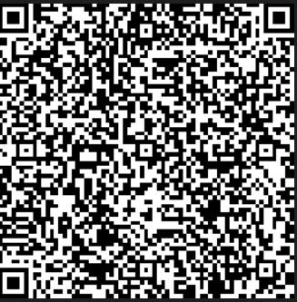
GOBEL
Case Study
Grateful Patient Program
How F&MCW Identified $10M in New Prospects Through Grateful Patient Referrals
QR Code
Scan QR Code to access the full case study →
20

Slide 22

HCP Donor Highlight: Alice
GOBEL
“Alice’s story illustrates the profound impact of grateful patient philanthropy — transforming a healing experience into a lasting gift that helps others."
Patient / Donor
Photo
HCP Grateful Patient Program — F&MCW
21

Slide 23
F&MCW HCP Reports Library
GOBEL
HCP Prospect Status
Clinician Metrics
Referral Metrics
Major Gift HCP
Opportunities Closed
Opportunities Asked
Unmatched HCP
HCP Tracking Sheet
22

Slide 24
F&MCW HCP Program Dashboard
GOBEL
$12,536,311
$ 12,089,095
$447,216
885
Total Raised
Solicited Closed
Unsolicited Closed
Total Patient Referrals
162
49
160
11
Prospects Qualified
Solicited Gifts Closed
Unsolicited Gifts Closed
Development Officers
56
149
169
Avg Days Letter to First Outreach
Avg Days Letter to Qual Action
Avg Days to Qualification Action
23

Slide 25
Future Enhancements
GOBEL
01
02
03
In Development
Planned
On Roadmap
Priority Prospects
Filter Enhancements
Expanding Additional Service Lines
Intelligent prioritization of prospects based on giving capacity, clinician relationship strength, and engagement signals.
Advanced filtering across service lines, geographies, gift ranges, and engagement timelines for sharper reporting.
Extend the program to new service lines and fully integrate across EHR, CRM, and fundraising platforms.
24

Slide 26
Lessons Learned
GOBEL
Key = Leadership Support
Executive champions accelerate adoption and reinforce philanthropy as an important aspect of patient care.
Consistent Training
Regular refresher trainings ensure teams understand the why behind grateful patient engagement — not just the process.
Start Simple, Then Iterate
Launch with a few meaningful KPIs initially; then expand as adoption grows.
Celebrate Early Wins
Sharing success stories reinforces behaviors and builds enthusiasm around the program.
25

Slide 27
Lessons Learned
GOBEL
Transparency Builds Trust
Clearly define how data is collected, utilized, and shared to increase the team's confidence in the dashboard.
Integrate into Existing Workflows
Embedding dashboards into existing meetings, reports, and systems drives sustained use.
Create Feedback Loops
Provide opportunities for staff to make recommendations on improvements and highlight gaps in metrics.
"A dashboard does not change culture, people do. Data helps us see the opportunities to care, connect, and inspire philanthropy."
26

Slide 28

Audience Q&A
What's your next step?
Connect with us for a free consultation at bizdev@gobelgroup.com
Notes:
We're coming up on time, and I want to give each of you a moment for a final thought that you wanted to be sure to share with our audience today.
Each panelist offers a brief (60-second) closing reflection or call to action.
[Greta — Closing] Thank you to our panelists — Ashley, Tricia, Jason— for sharing not just your expertise, but the real, on-the-ground experience that makes this conversation so valuable.
Rural hospitals are more than healthcare facilities. They are anchors of community life. Philanthropy has a meaningful role to play in keeping them strong — and I hope today has given you both the inspiration and the practical tools to take your next step.

Slide 29
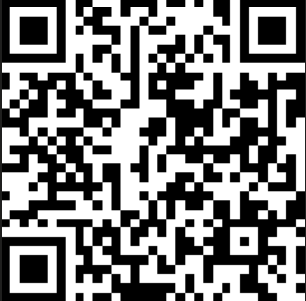
GOBEL
Thanks!
Connect with a GOBEL expert to explore strategies for Grateful Patient Fundraising today!
Scan the QR code to schedule a free consultation.
QR Code
Contact Us
27

